Slide 1
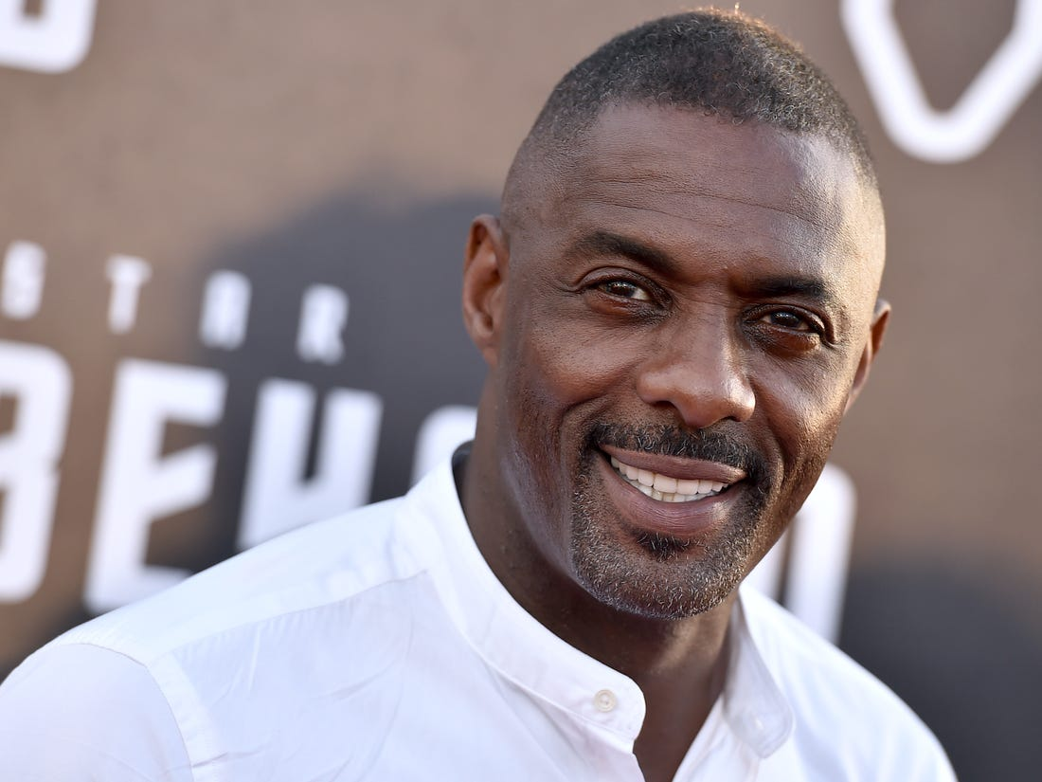
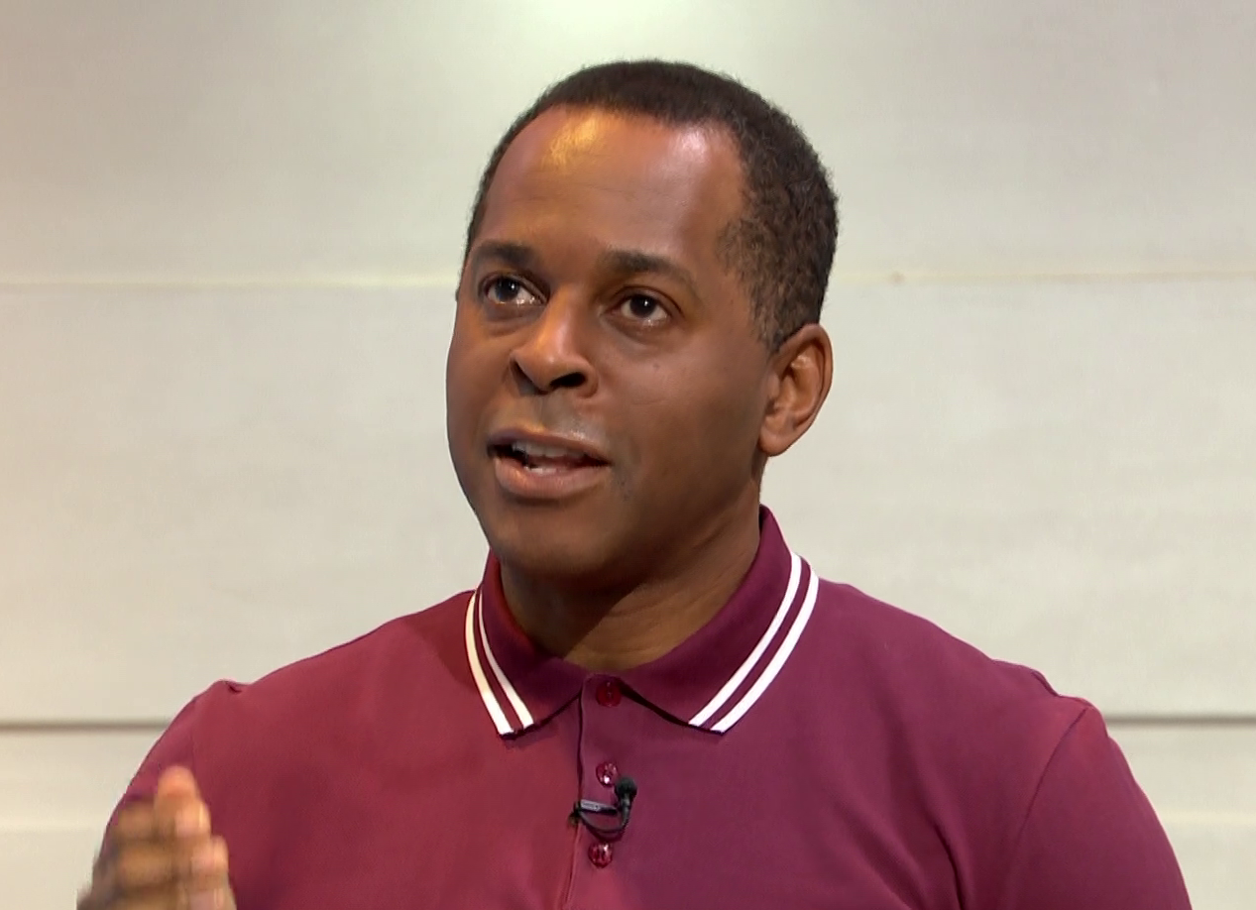

Black History Month
In Blue Gate Infant’s School
Idris Elba - actor
Andi Peters - presenter

Slide 2
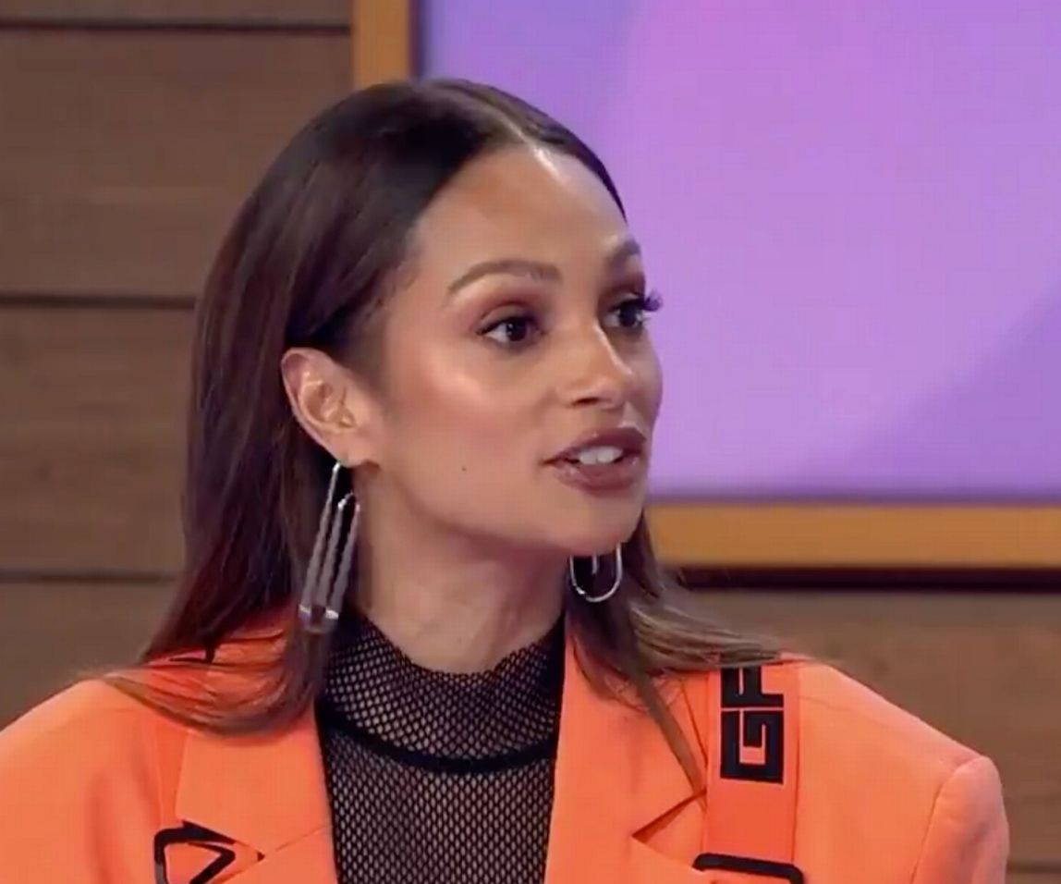
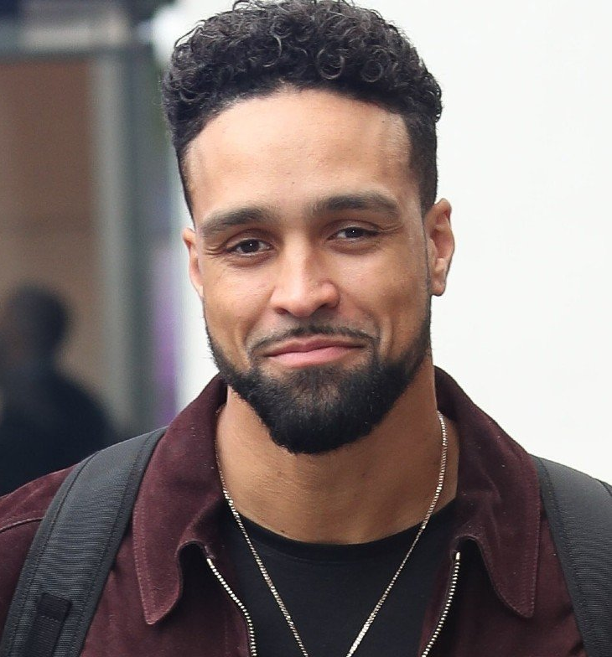
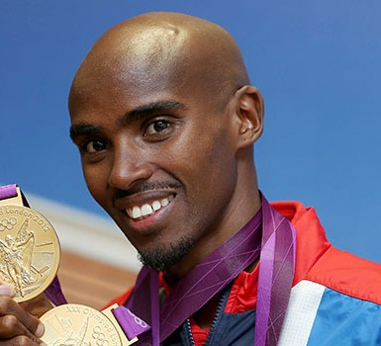
Alesha Dixon
Ashley Banjo
Mo Farah
British successful celebrities, choreographers and sports people….

Slide 3
What is Black History Month and why do we celebrate it UK?
It began as a way of remembering important people and events in the history of the African scattered population, whose origin lies in a separate geographic locale. It is celebrated in February in the United States and Canada, while in Ireland, the Netherlands, and the United Kingdom it is observed in October.

Slide 4
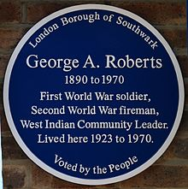
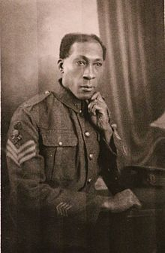
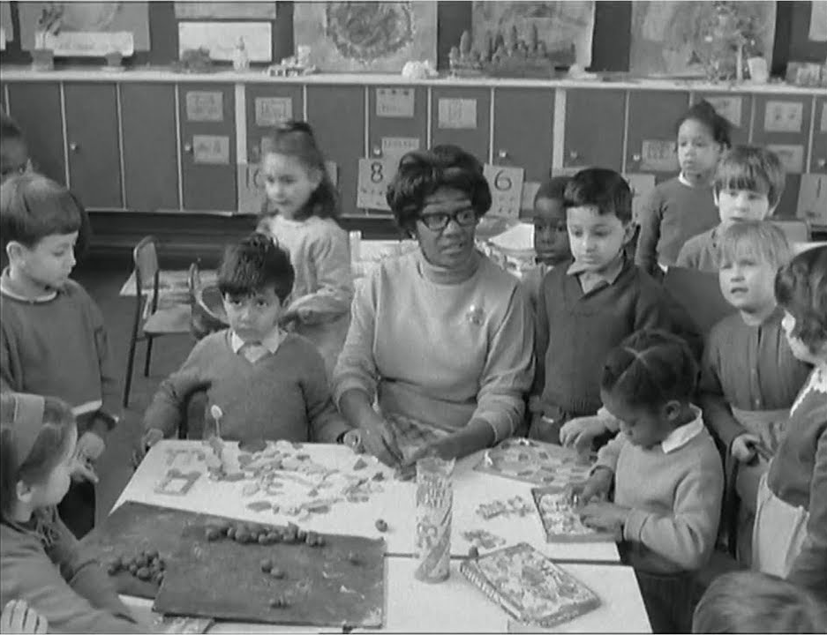
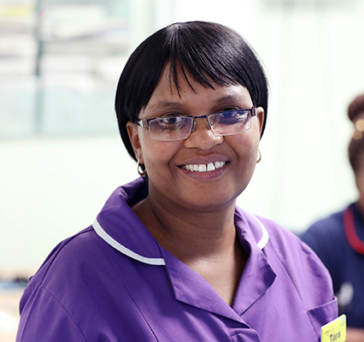
So what is Black History Month?
https://youtu.be/F2k-Uw8dIfA
Please click on youtube link
Prime Minister Boris Johnson marks Black History Month October 2020
George Arthur Roberts
soldier & firefighter
Yvonne Connolly
first black headteacher
Taurai Matare
Nurse of the year 2019

Slide 5

So let’s celebrate two important people who helped shaped Britain become who we are now….

Slide 6
Yvonne Connally – Head teacher
https://youtu.be/WBeZigeTL4g
Please click on youtube link
Yvonne Connolly
first black headteacher

Slide 7
Taurai Matare – Nurse of the year 2019
https://youtu.be/iMSH-0RMF5U
Please click on youtube link
Taurai Matare
Nurse of the year 2019

Slide 8
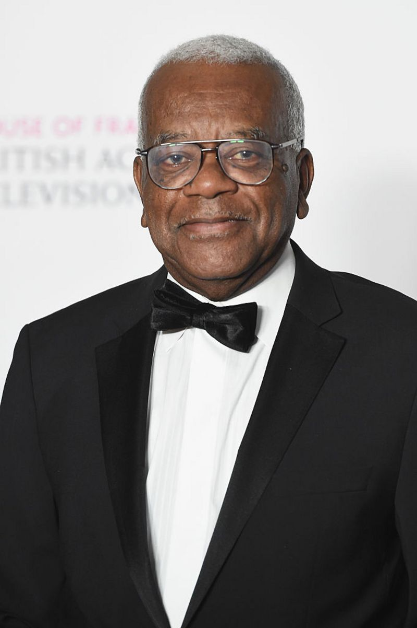
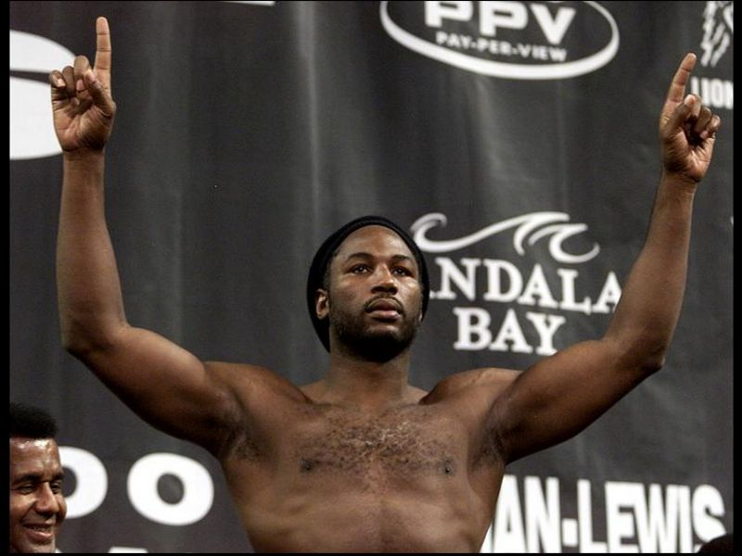
Black people who have been successful
in Britain
Do you know who they are?

Slide 9
Sir Trevor MacDonald (1939-today)
You may have seen his face on the television before, as Sir Trevor MacDonald is one the most well-known presenters on TV in Britain.
He was born in Trinidad where he worked in the media, but came over to Britain in the late 1960s to work for the BBC in London.
He later moved to a different organisation called ITN and went on to become one of the most successful journalists in the country.
In 1999, he received a knighthood from the Queen for his work.

Slide 10
Lennox Lewis (1965-today)
In the world of sport, Lennox Lewis is one of the most successful British sportsmen of all time and his name is known all over the world.
He was a boxer who won 41 of his 44 professional fights, which is a pretty amazing record.
He announced his retirement from the sport in 2004, after his final fight on 21 June 2003 against the Ukrainian boxer Vitali Klitschko.

Slide 11
How can we help towards Black History Month and beyond?
Respect others
Be kind to each other
Share and help each other
Be optimistic and set yourself a goal to achieve.
Work hard and believe in yourself!

Slide 12


